Slide 1

Sales Forecasting for Retail Using Machine Learning Models
Student Id: 23097024
Student Name: MAHESH GARIKE
Notes:
This slide presents an introduction of the project including the title that it is aimed at the sales forecasting with the use of machine learning to gain practical experience. Discuss the purpose of the project and state that it is expected to help in inventory and demand management in the retail business.

Slide 2
Research Question
Research Question: How can machine learning models be used to forecast sales for retail stores accurately?
Explore the need for predictive models in retail.
Identify challenges retailers face in demand forecasting.
Discuss the role of data science in improving sales predictions.
Sales prediction models are crucial for efficient inventory management.
We aim to optimize prediction accuracy using advanced machine learning models.
This research is key to helping retail businesses reduce excess inventory and stockouts.
Notes:
The overall problem that can be addressed in the research question is to comprehend how the machine learning can address real world business challenges such as sales forecasting. Make sure to note that machine learning has the potential to develop scalable, adaptable and accurate forecasting models

Slide 3
Background
Machine learning has proven beneficial for retail sales prediction.
Time-series forecasting techniques, such as ARIMA, were traditionally used.
However, modern techniques like Random Forest, XGBoost, and LSTM have shown better accuracy.
Previous research highlights the need for more data-driven approaches in retail forecasting.
Studies have proven the value of demand forecasting in reducing inventory costs.
A blend of traditional and machine learning models is being explored.
Notes:
In this part, briefly state the classic approach, such as ARIMA and how machine learning model has advanced to be a better approach. explain why there has been a vacuum in the existing research, which you are attempting to fill using more sophisticated models.

Slide 4
Dataset Overview
Dataset: Kaggle's Store Item Demand Forecasting Challenge.
Contains 5 years of daily sales data across multiple store locations.
Features: store ID, item ID, sales quantity, date, and promotional info.
Data is categorized into items, stores, and time periods.
Goal: Predict sales for 3 months based on historical data.
Dataset enables machine learning models for time-series analysis and forecasting.
Notes:
This dataset also is a good fit in retail forecasting because it will give the history of sales trends, which in turn will be used to come up with forecasting models. Highlight how it will enable you to address real-world problems in retail, giving the models a practical foundation.

Slide 5
Ethical Considerations
Data used does not include personal information.
No private customer data is involved.
Dataset is publicly available through Kaggle under a Creative Commons license.
Ethical considerations around data usage are addressed through licensing agreements.
The data meets GDPR compliance standards.
You have ensured all data is anonymized and used responsibly.
Notes:
Address the ethical implications of any data science project by telling that you have not involved personal data with a high degree of sensitivity, and that the information is legal.Get to the point of addressing the ethical aspect of any data science project by stating that you have taken job of ensuring that the data used in any project is of legal value.

Slide 6
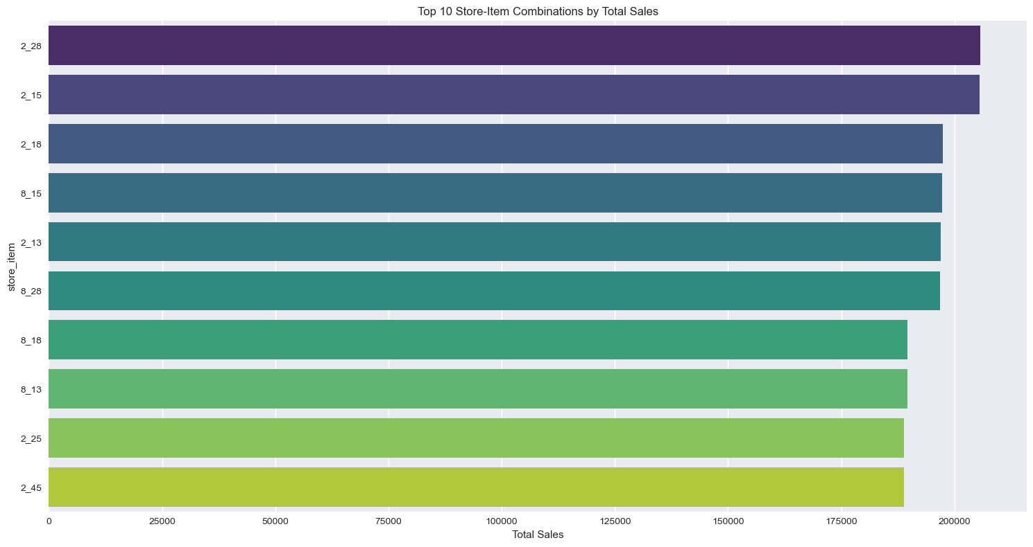
Perform initial analysis to understand data distribution.
Identify any outliers or trends in the sales data.
Visualize sales patterns over time using line graphs.
Show seasonal trends and periodic fluctuations in sales.
Correlate promotional events with sales spikes.
Highlight missing values and decide on imputation methods.
Exploratory Data Analysis (EDA)
Notes:
EDA assists visualizing the data structure and the features of the data.In this section, you will describe your sales per time so that you can see the patterns or trends of sales. Mention that you will seek whether there are seasonal influences on the selling (such as holiday sales).Mention that you will be seeking how the trends may modify the quality of the models

Slide 7
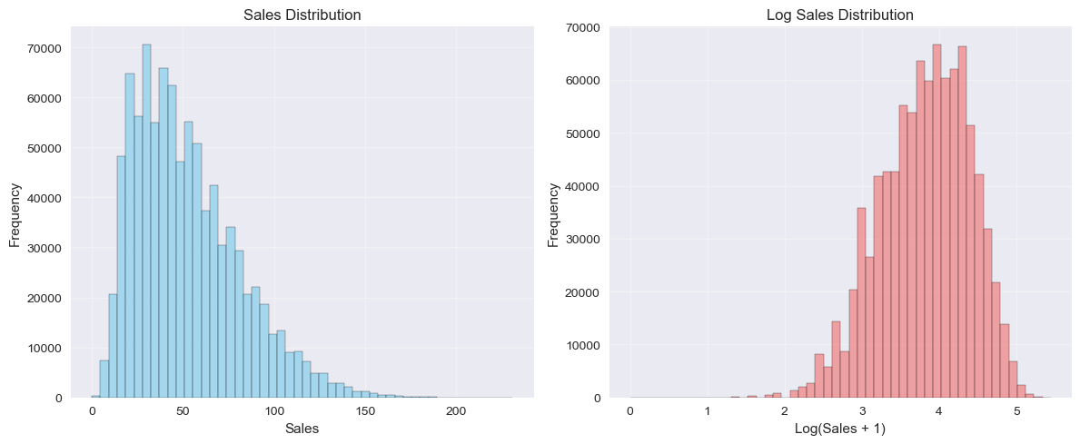
Data Preprocessing
Handle missing values using imputation or removal.
Normalize numerical data to improve model performance.
Encode categorical data (e.g., store, item ID) using one-hot encoding.
Feature engineering to include date-related features (e.g., day of the week, month).
Split data into training and test sets for model validation.
Check for multicollinearity and remove correlated features.
Notes:
Debrief on the preprocessing of machine learning models and how to make sure that all your data is available to train your model.Talk about the role of working with missing values, why it is necessary to clean up your data by normalizing and encoding, and how feature engineering can be used to improve your model performance by time-series data.

Slide 8
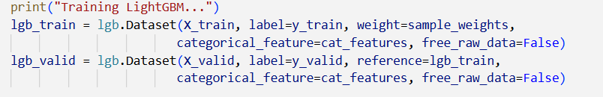
Model Implementation
Models used: Linear Regression, Random Forest, XGBoost, LSTM.
Each model has unique strengths for forecasting.
Linear Regression provides a baseline for predictions.
Random Forest and XGBoost offer high flexibility and accuracy.
LSTM is used for deep learning on time-series data.
Models are trained using the training dataset and evaluated with test data.
Notes:
This slide summarizes our machine learning models of what you are using.Mention that each of the models has its advantages, but it is concluded that Linear Regression is simple and offers a baseline, whereas Random Forest and XGBoost are stronger in addressing complex relationships within the data.LSTM is a deep learning model which is specially fitted in a time-series forecasting and it will be used here to capture time-based dependencies.

Slide 9
Hyperparameter Tuning
Grid Search: Tuning model parameters to improve accuracy.
Cross-Validation: Validate model performance on unseen data.
RandomizedSearchCV: Explore hyperparameter space more efficiently.
Tuning criteria: Optimize for RMSE and MAE.
Results from grid search lead to improved model selection.
Comparison of hyperparameter effects on model performance.
Notes:
Introduce Hyperparameter tuning Hyperparameter tuning ensures that the model is performing optimally.Talk about how the models are able to minimize RMSE (Root Mean Squared Error) and MAE (Mean Absolute Error) because they are common metrics used to evaluate regression and forecasting tasks.

Slide 10
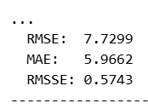
Results Interpretation
Model performance metrics: RMSE, MAE, and R².
XGBoost showed the best performance with an RMSE of 5.3.
Random Forest also performed well with an RMSE of 6.1.
LSTM underperformed on this dataset due to overfitting.
The models generally predicted sales trends accurately.
Discuss how the results align with or differ from the literature.
Notes:
Discuss the performance of both models and how each performed according to such important metrics as RMSE and MAE.Note that XGBoost did better than LSTM, which is possibly because it allows modeling complex relationships.Relate your results to the literature on sales forecasting.

Slide 11
Summary & Conclusions
The best-performing model was XGBoost, with the lowest RMSE.
Sales forecasting can significantly improve inventory management and decision-making.
Retail businesses can optimize stock levels and reduce waste.
Future improvements could include deeper models like CNNs for feature extraction.
Time-series forecasting models have a wide range of applications.
Conclusion: Machine learning models, especially XGBoost, provide effective retail sales predictions.
Notes:
Conclude the most important message: XGBoost was the optimal in terms of this dataset, but it is possible to make it better with more sophisticated models such as CNNs. Explain how your results can assist retail stores to manage inventory by minimizing stock-out and excess inventory. Mentions the real-life uses of these forecasting models in other industries and non-retail sectors. Finish by pointing out what might be better with your approach in the future.

Slide 12
References
dairu, X. and Shilong, Z. (2021). Machine Learning Model for Sales Forecasting by Using XGBoost. [online] IEEE Xplore. doi:https://doi.org/10.1109/ICCECE51280.2021.9342304.
Koesten, L., Vougiouklis, P., Simperl, E. and Groth, P. (2020). Dataset Reuse: Toward Translating Principles to Practice. Patterns, 1(8), p.100136. doi:https://doi.org/10.1016/j.patter.2020.100136.
Lee (2023). #7 What is the Data Preprocessing(Missing data, One-hot encoding, Feature Scaling). [online] Medium. Available at: https://medium.com/@musicaround/7-what-is-the-data-preprocessing-missing-data-one-hot-encoding-feature-scaling-771f54b6ead1 [Accessed 21 Nov. 2025].
Shah, R. (2021). GridSearchCV |Tune Hyperparameters with GridSearchCV. [online] Analytics Vidhya. Available at: https://www.analyticsvidhya.com/blog/2021/06/tune-hyperparameters-with-gridsearchcv/ [Accessed 21 Nov. 2025].

